Slide 1
Vehicle Interaction Control Improvement Project
Vehicle Interaction Knowledge Hub Resource - Story Board Series
5.0 Wet Roads due to Overwatering
Version October 2020

Slide 2
Adapting and Using EMESRT Story Boards
What are they?
The Story Board approach was developed by an EMESRT Member Company to assist with the specification and installation of Proximity Detection Systems (PDS) on mobile equipment at surface mines
They provide a visual and dynamic reference for equipment operators, PDS suppliers VI Control Improvement project managers as they implement VI intervention controls (EMESRT Levels 8–9)
How can I use them?
Review each Story Board in presentation mode
As required, adapt the resource to your circumstances
Use the Story Boards as a resource during Phase 4 - New Technology Implementation

Slide 3
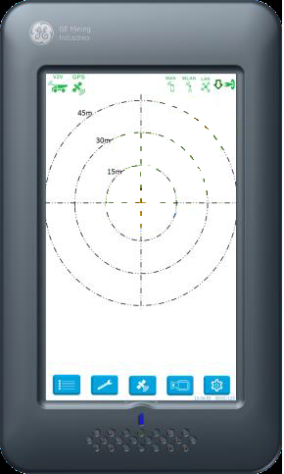
Wet Roads Due to Overwatering
Local Object (LO) = Haul Trucks, LV’s & Service Trucks @ >15kph
Water Cart Remote Object (RO) enables watering system
Triggers bread-crumbing / wet road hazard geofence
When the outer beam of LO breaches the edge of the “Wet Road” bread-crumbs, screen will brighten, and two prompts will be presented to the LO
An icon appears indicating road has been watered ahead
Audible ”Wet road ahead”
Parameters
Bread-crumb/wet road hazard geofence remains detectable for a configurable time limit
Icon remains displayed on LO CAS screen until
LO leaves bread-crumb trail
The geofence timeout expires (based on individual bread crumb expiry)
Audible should trigger once only per entry into geofence
Dependencies –
Water Cart and all other equipment will have to communicate with the server in real-time throughout the mine site (zero network blind spots) unless V2X will suffice
Not applicable for wheel loaders, dozers, graders, drills, scrapers, cable reelers, and tracked loading units
Reference EMESRT PR5A for further information and context.

